Slide 1
TOURIST ATTRACTIONS OF OUR REGION Liguria San paragorio’s church

Slide 2
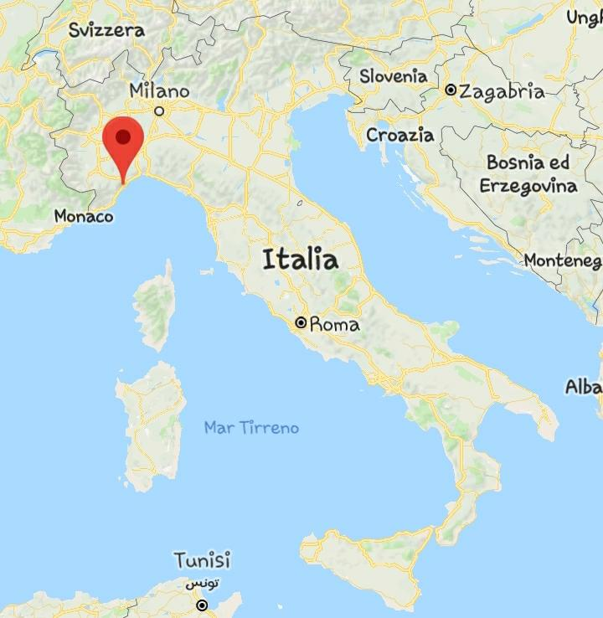
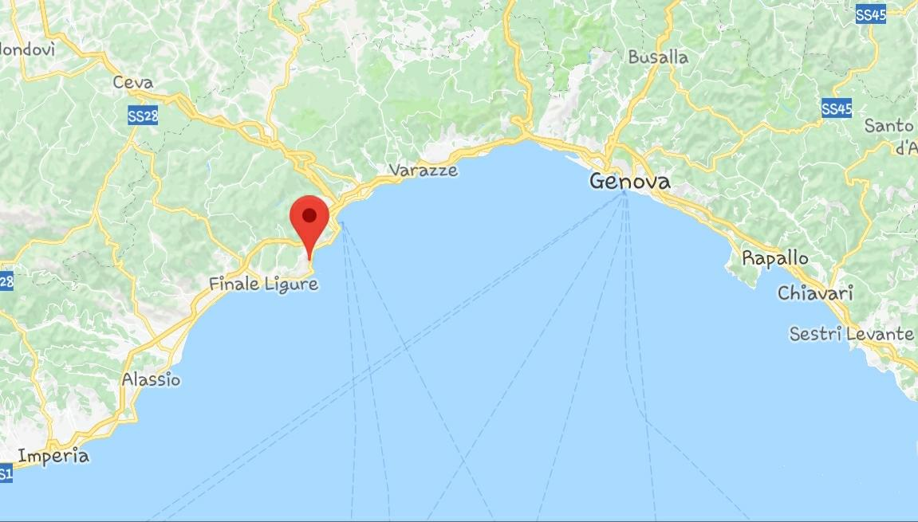
LIGURIA S. PARAGORIO’S CHURCH
LOCATION
Map of the country
Map of the area with other sites

Slide 3
LIGURIA S. PARAGORIO’S CHURCH
TYPE OF SITE
Archeological and Monumental site
PHYSICAL AND AESTHETIC FEATURES
It is an early Romanic church, it has a bell tower and beside the entrance there are four tombs.
Beneath the church you can find another older church , 30 cm below sea level
AREA COVERED
400 m2
HISTORICALand ARTISTIC INFORMATION
One of the most important attractions of the church is the «Volto Santo» (Holy Face), Christ on a cross of the Byzantine area, Its head is made of cloth unified with natural glue and the entire body is made of wood covered by cloth ,painted in blue , which stands for the color of a king or an emperor ‘s clothing.
Another attraction that you can see in the church is a cover of a floor tomb,
It is unusual because it is rounded and it is made of marble and slate.
DATING
Built between 1020 and 1030

Slide 4
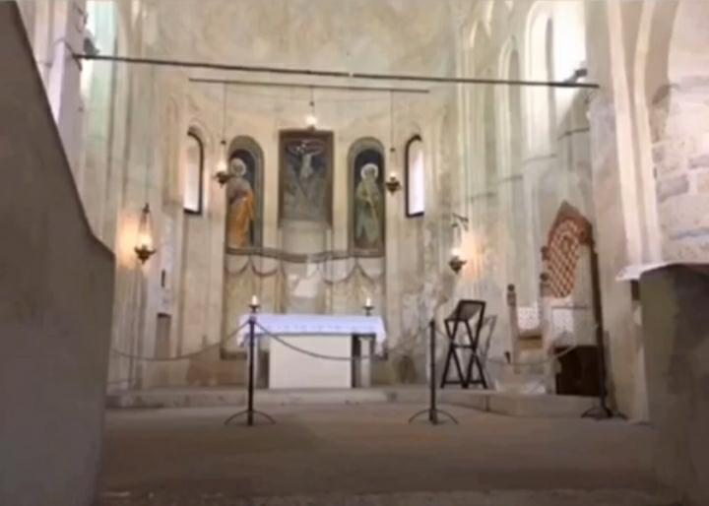
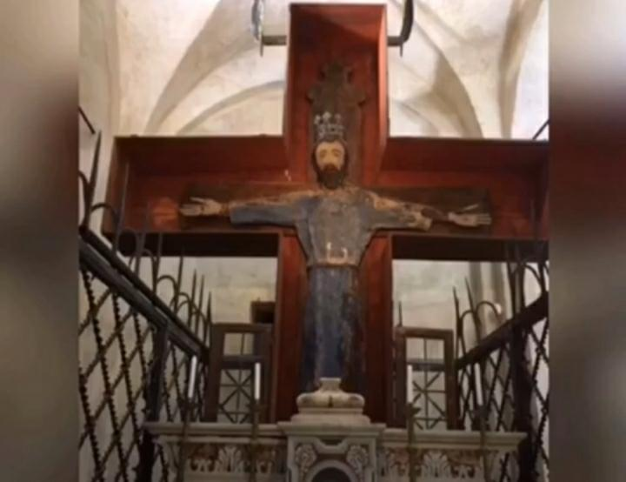
LIGURIA S. PARAGORIO’S CHURCH
HIGHLIGHTS
S. Paragorio’s altar
Wooden Christ

Slide 5
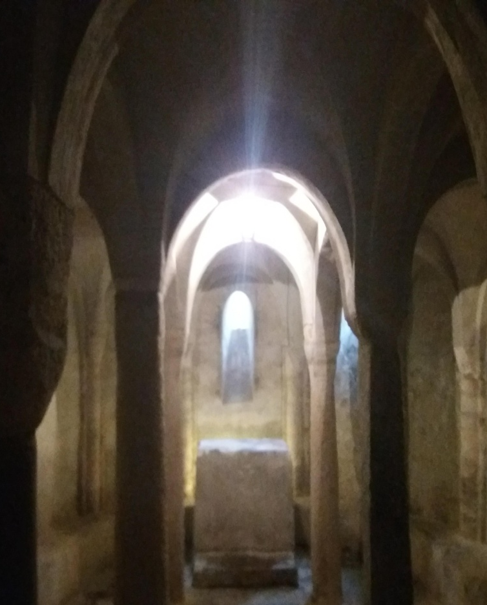
LIGURIA S. PARAGORIO’S CHURCH
CONDITION OF PRESERVATION
The church was restored in 1975 by the «Sovraintendenza delle Belle Arti» and so it is in perfect condition
VISITING TIME
Winter:
Saturday/Sunday from 10 to 12 am, from 4 to 6 pm
Tuesday from 10 to 12 am
Summer:
Same opening times plus Thursday from 10 am to 6 pm
LEGAL OWNERSHIP
The Diocesis of Savona Noli
TICKETS AND BOOKING
Adult : 2€
Child (8-18): 1.50 €
Child under 7 : free
Guided visits are available upon booking

Slide 6
LIGURIA S. PARAGORIO’S CHURCH
ACCESSIBILITY
It is accessible to disabled people
FACILITIES
Near the site there are restaurants, bars and shops.

